Slide 1
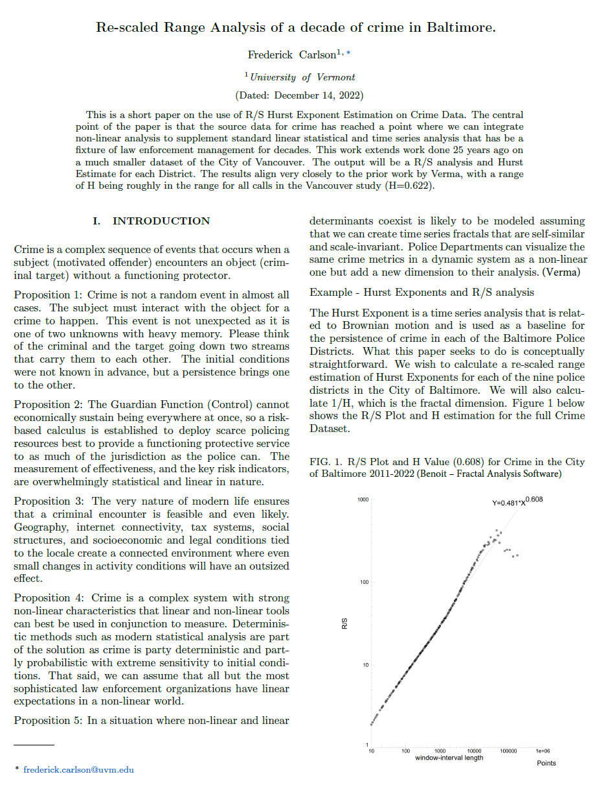
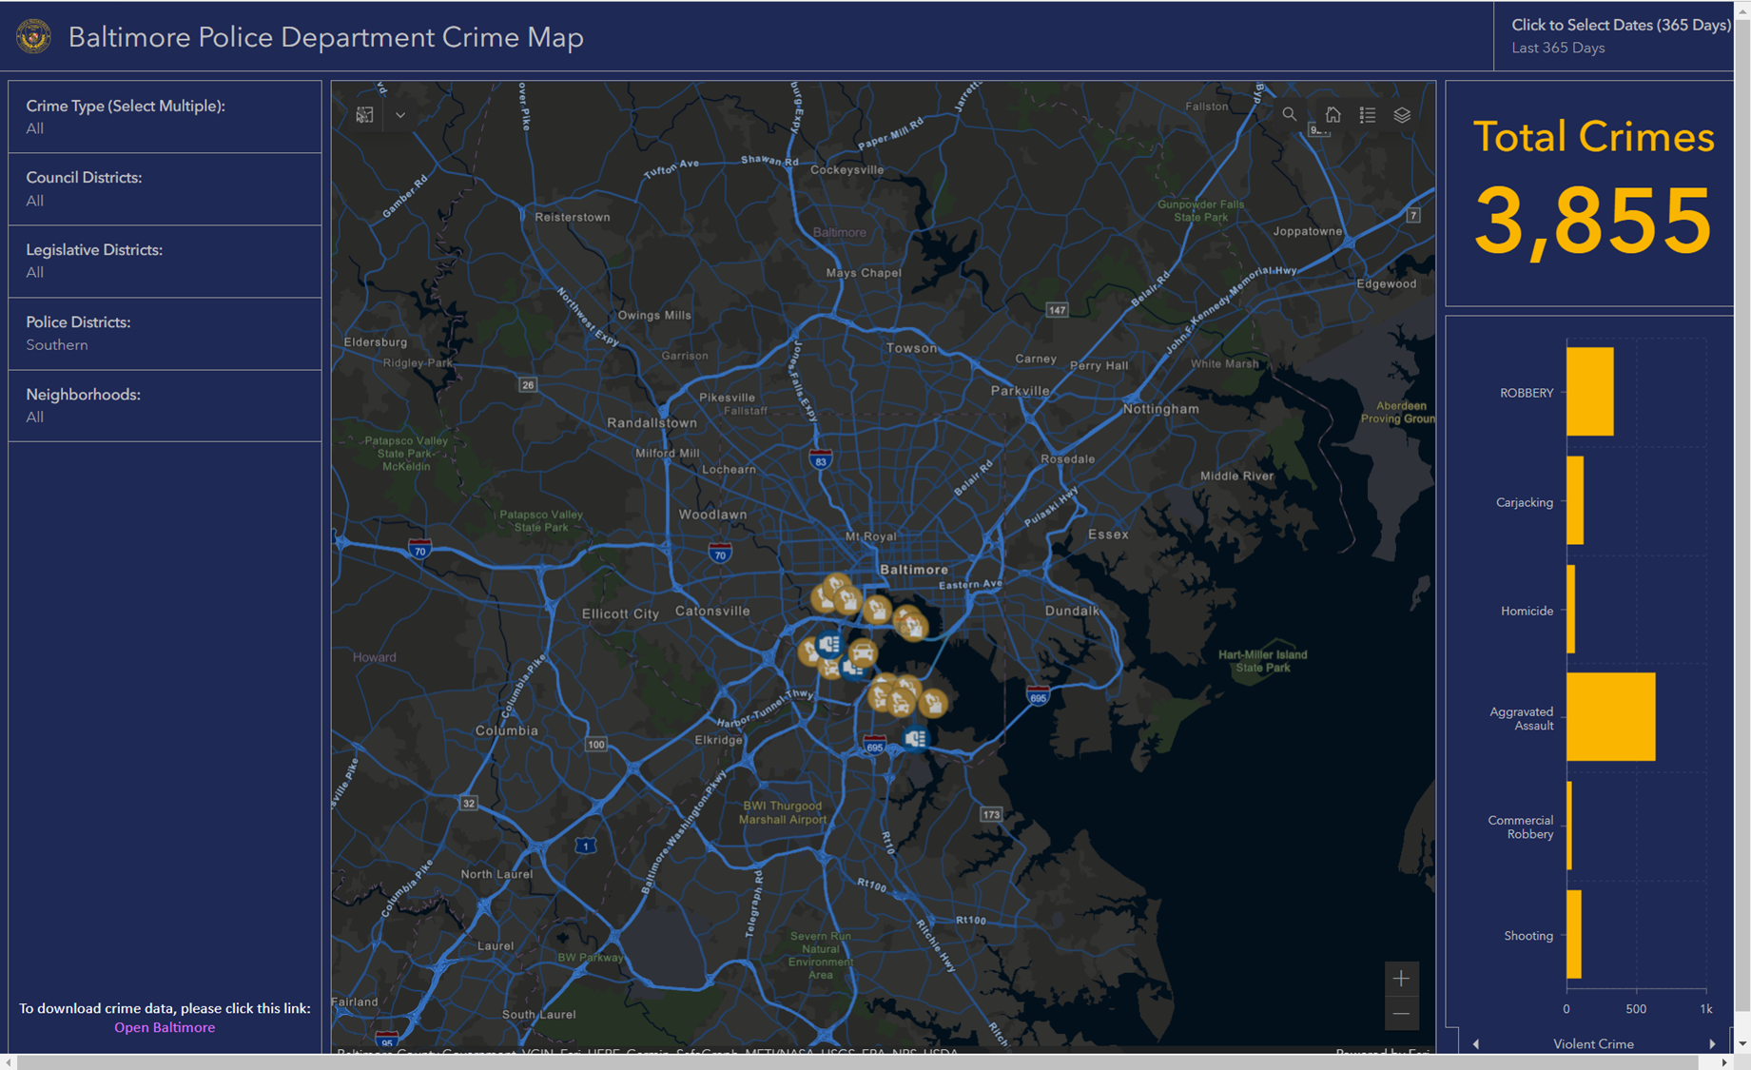
Rescaled Range Analysis of a decade of crime in Baltimore
https://github.com/T4rnover/PoCS_Final_Paper
Frederick R. “Randy” Carlson

Slide 2
First of at least three parts
Goal – Do a rescaled range Hurst Estimate of Crime in Baltimore’s Police Districts.
Tools: Minitab, R and Possibly a (very) old tool called Benoit.
Results, a persistence value and some sort of simple value per district. Secondary goal: Cross Check with R Package.
Data: From Open Baltimore.

Slide 3
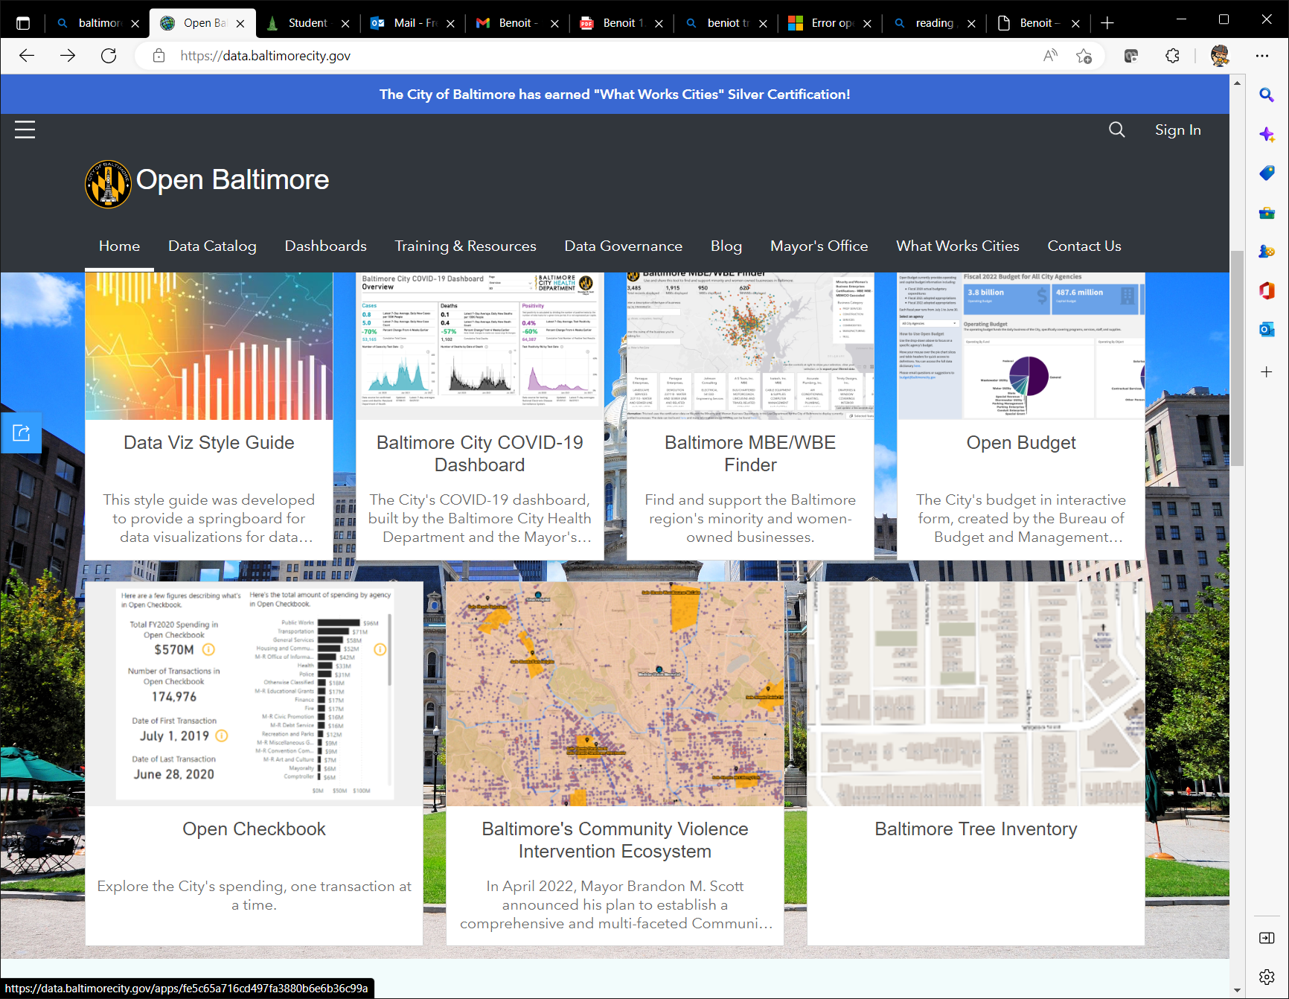
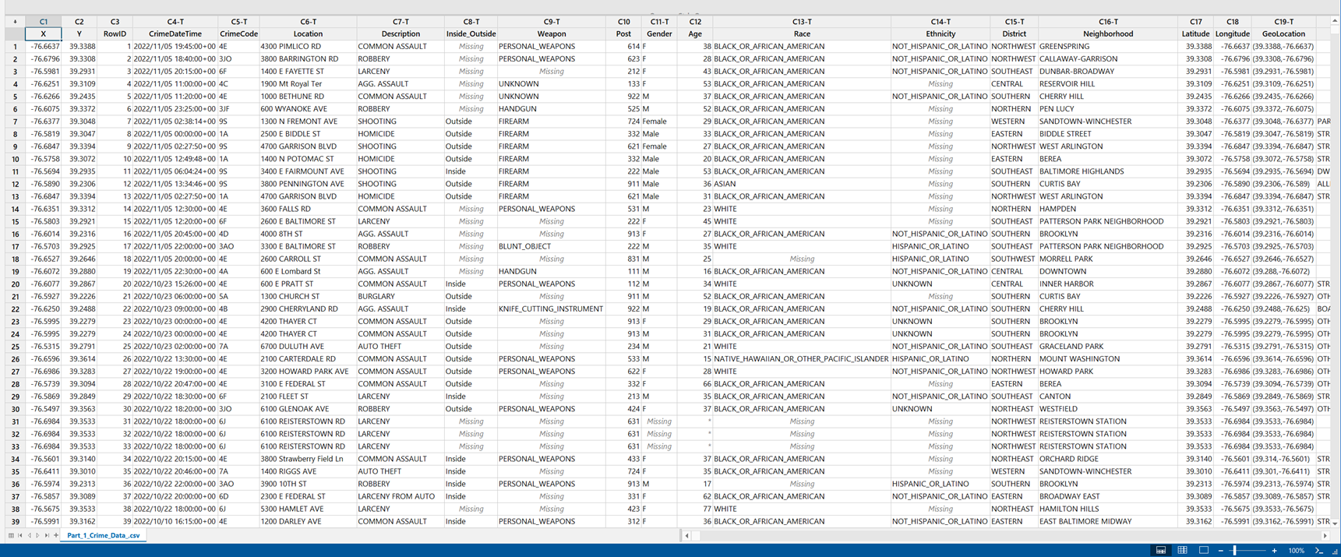
Data!!
Not really an issue
Baltimore PD has excellent data sources.
Minitab an absolute life saver.

Slide 4
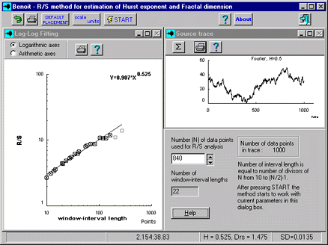
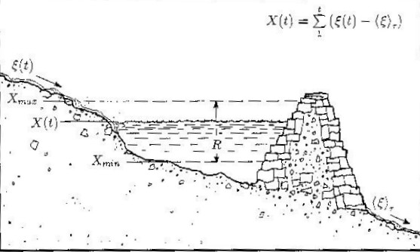
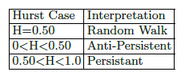
Model and Measurement – Hurst Exponents!!
It’s not just for Stock Markets!!
Invaluable “before it’s time” 1998 paper from Indiana Criminologist Anvind Verma showed that R/S range estimation was feasible.
We have much, much more data than 25 years ago.

Slide 5
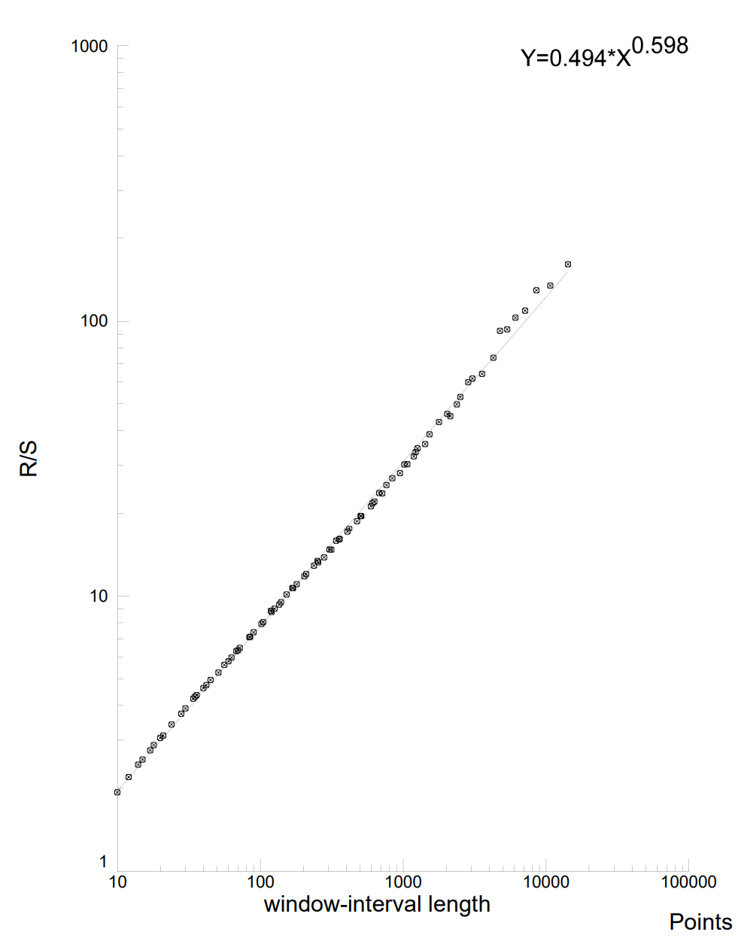
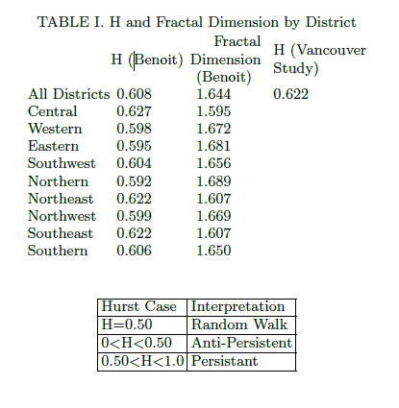
Results!!
R/S - Western District

Slide 6
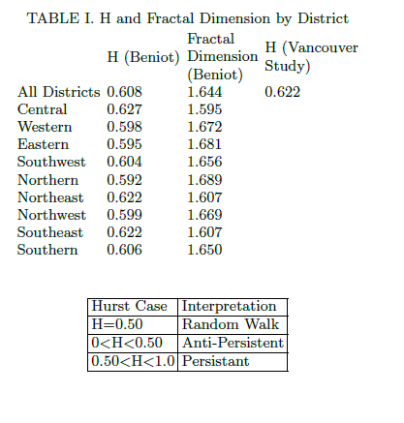
Second Check
Use R “Pragma” Package
Has Hurst Estimation Function
The H estimated from the R package is 0.600 for the
Southwest District and 0.571 for the Western District.
This is a difference o f - 0.004 for the Southwest District
and -0.027 for the Western District.
These results seem solid but should be taken with a grain
of salt.

Slide 7
References
Baltimore Police Department, https://www.baltimorepolice.org/.
Benoit – Fractal Analysis Software, http://www.trusoft-international.com/.
MELGAREJO, MIGUEL, and NELSON OBREGON. “Multifractal Approach to the Analysis of Crime Dynamics: Results for Burglary in San Francisco.” Fractals, vol. 25, no. 05, 2017, p. 1750043., https://doi.org/10.1142/s0218348x17500438.
Open Baltimore, https://data.baltimorecity.gov/.
Peters, Edgar E. Chaos and Order in the Capital Markets: A New View of Cycles, Prices, and Market Volatility. John Wiley & Sons, 1996.
“PRACMA: Hurst – R Documentation.” Quantargo, https://www.quantargo.com/help/r/latest/packages/pracma/2.3.3/hurst.
Schroeder, Manfred Robert. Fractals, Chaos, Power Laws: Minutes from an Infinite Paradise. Dover Publications, 2020.
Verma, Arvind. “The Fractal Dimension of Policing.” Journal of Criminal Justice, vol. 26, no. 5, 1998, pp. 425–435., https://doi.org/10.1016/s0047-2352(98)00021-x.

